Slide 1
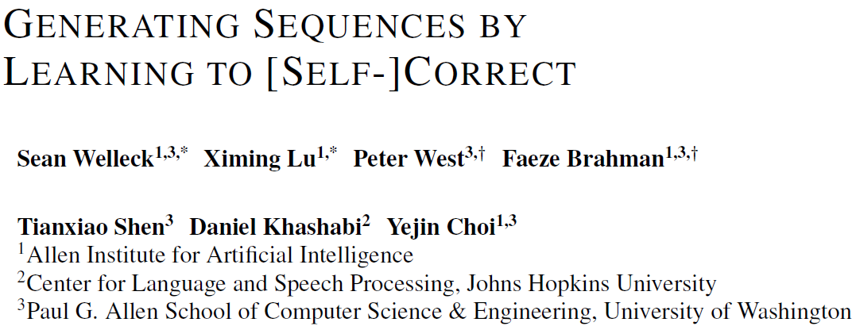
ICLR 2023

Slide 2
Abstract
Background:
Sequence generation applications require satisfying semantic constraints, such as ensuring that programs are correct, using certain keywords, or avoiding undesirable content
LLMs (whether fine-tuned or prompted with few-shot demonstrations) frequently violate these constraints, and lack a mechanism to iteratively revise their outputs
Moreover, some powerful language models are of extreme scale or inaccessible, making it inefficient to update their parameters for task-specific adaptation
Notes:
序列生成模型通常需要满足一些语言限制，比如要求生成正确的程序，或者生成出包含特定关键字的文本，抑或是避免生成出不良的内容
LLM通常会无法完全满足这些限制，并缺乏一种机制来迭代式的修改模型的生成结果
此外，这些模型参数较大，从而难以针对特定任务要求进行模型参数的更新

Slide 3
Abstract
Approach:
We present SELF-CORRECTION, an approach that
decouples an imperfect base generator (an off-the-shelf language model or supervised sequence-to-sequence model)
from a separate corrector that learns to iteratively correct imperfect generations.
To train the corrector, we propose an training procedure that can use either scalar or natural language feedback on intermediate imperfect generations
SELF-CORRECTION improves in three tasks: mathematical program synthesis, lexically-constrained generation, and toxicity control
Notes:
因此本文提出了一种自校正模型
该方法将以往的语言模型拆解为一个基础的生成器，以及另外一个矫正器
并使用矫正器迭代式的修改生成器输出的结果
为了对矫正器进行训练，本文提出了一种新的训练流程，
其能够基于评测指标测出来的数值或者自然语言反馈
指导模型对生成文本进行矫正
数学程序生成
词汇约束生成
毒性控制

Slide 4
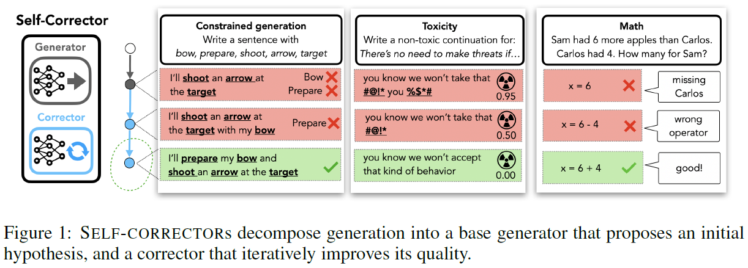
Introduction
Central principle:
the base generator produces a reasonable initial hypothesis but does not need to solve the task in one pass
the corrector is trained to make up the difference between the hypothesis and an optimal solution
Neither the generator nor the corrector must solve the full task in one pass, and the corrector can be applied multiple times to iteratively improve the output
Notes:
本文方法并不要求生成器或者矫正器一次性地完成生成任务
而其中生成器可以多次迭代使用来改善生成器的生成结果
本文方法的流程如图所示
此外图中也展示了三个任务的具体样例
(大致讲一下任务怎么做的）

Slide 5
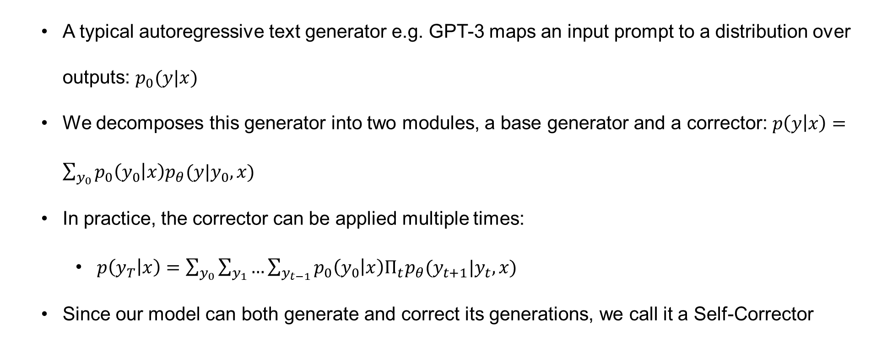
Approach
A typical autoregressive text generator e.g. GPT-3 maps an input prompt to a distribution over outputs: $p_{0}(y|x)$
We decomposes this generator into two modules, a base generator and a corrector: $p\left(y | x\right)=\sum_{y_{0}}{p_{0}\left(y_{0} | x\right)p_{θ}(y|y_{0},x)}$
In practice, the corrector can be applied multiple times:
$p\left(y_{T} | x\right)=\sum_{y_{0}}{\sum_{y_{1}}{…\sum_{y_{t−1}}{p_{0}\left(y_{0} | x\right)Π_{t}p_{θ}(y_{t+1}|y_{t},x)}}}$
Since our model can both generate and correct its generations, we call it a Self-Corrector
Notes:
一个典型的自回归文本生成器，如gpt3，可以用公式具体表示为p0 y given x， x是prompt，y则是后续输出
本文将其拆解为两个模块，因此p y given x就可以改写成p0和p theta的乘积，然后在y0上进行求和
其中p0即为生成器，而p theta 则为矫正器
具体实现时矫正器可以多次使用，因此该公式可以进一步写为多个概率分布的连乘形式
那么因为本文方法同时可以进行生成以及矫正，因此本文将其称之为自矫正器

Slide 6
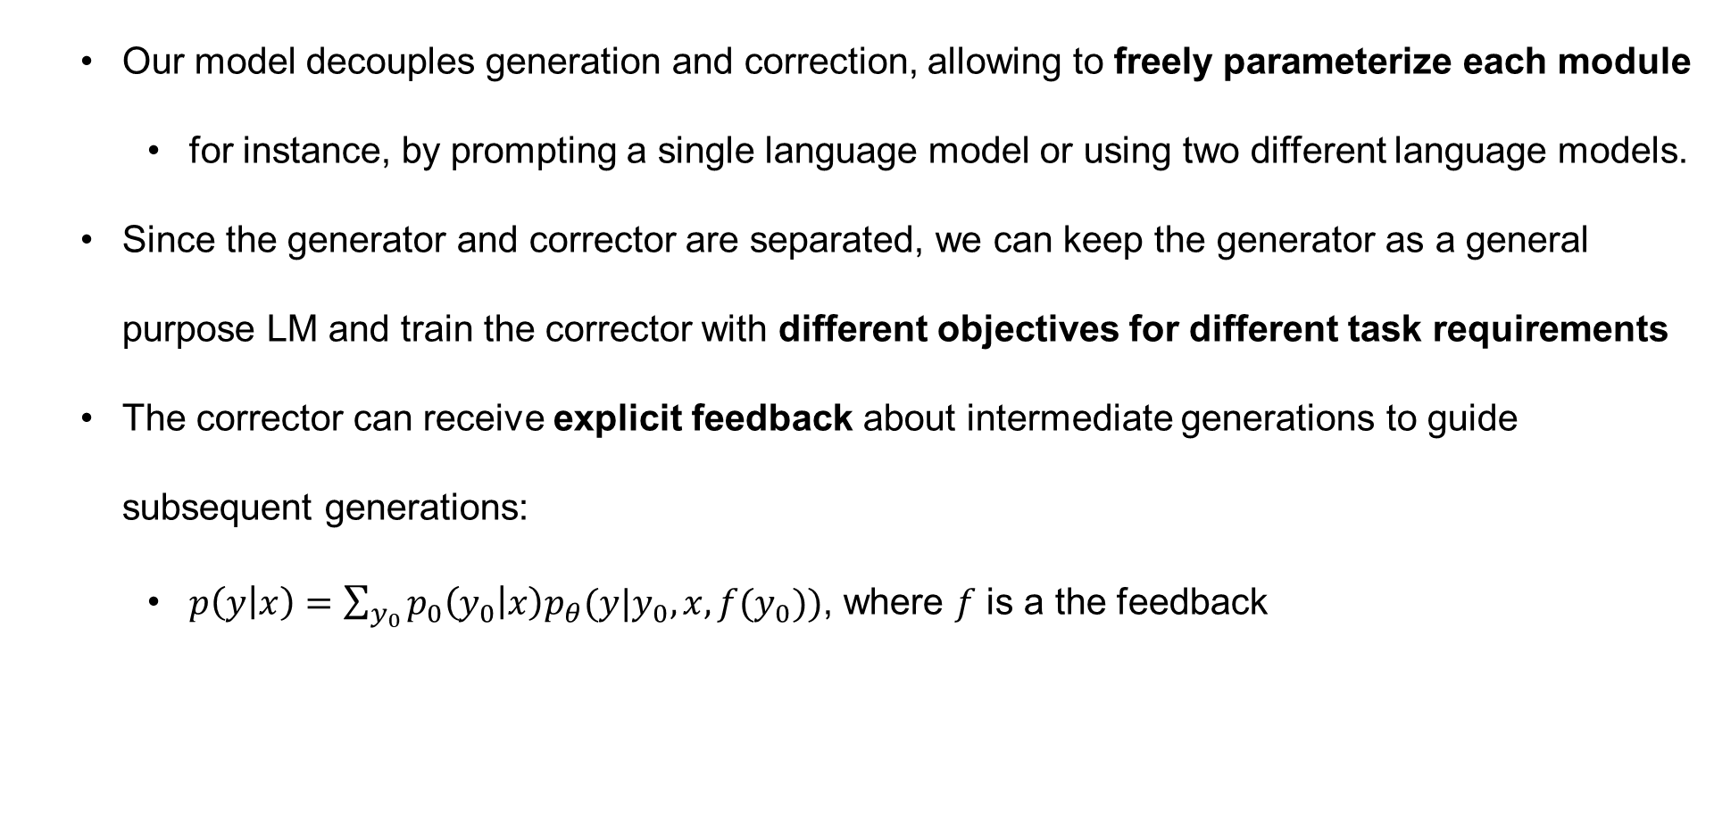
Approach
Our model decouples generation and correction, allowing to freely parameterize each module
for instance, by prompting a single language model or using two different language models.
Since the generator and corrector are separated, we can keep the generator as a general purpose LM and train the corrector with different objectives for different task requirements
The corrector can receive explicit feedback about intermediate generations to guide subsequent generations:
$p\left(y | x\right)=\sum_{y_{0}}{p_{0}\left(y_{0} | x\right)p_{θ}(y|y_{0},x,f(y_{0}))}$, where $f$ is a the feedback
Notes:
本文方法具有一些优势
其一，该方法将生成和矫正进行了解耦，因此可以自由地将每个模块进行参数化
比如可以在同一个LLM上使用不同的prompt来进行实现，也可以使用两个不同的语言模型来实现
其二，因为两个模块是分离的，所以可以使用通用的语言模型作为生成器，而根据不同任务的需要设置不同的矫正器
其三，矫正器可以进一步接受针对中间生成结果的显示反馈，从而更好地指引后续生成
该步骤可以将之前的公式进行改写，从而添加y0上的函数f，以作为对y0的反馈

Slide 7
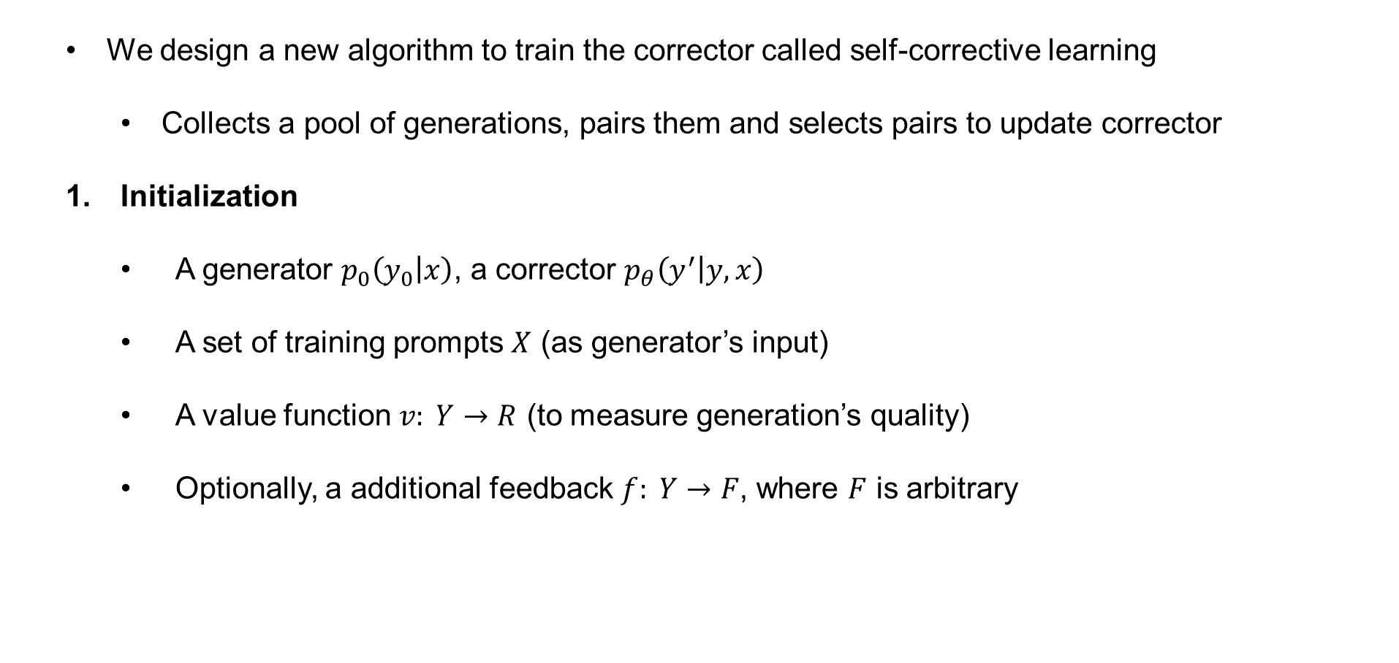
Approach: Learning a Corrector
We design a new algorithm to train the corrector called self-corrective learning
Collects a pool of generations, pairs them and selects pairs to update corrector
Initialization
A generator $p_{0}\left(y_{0} | x\right)$, a corrector $p_{θ}\left(y^{′} | y,x\right)$
A set of training prompts $X$ (as generator’s input)
A value function $v: Y→R$ (to measure generation’s quality)
Optionally, a additional feedback $f: Y→F$, where $F$ is arbitrary
Notes:
为了对矫正器进行训练，本文提出了自校正的学习算法，
其中主要包括将生成结果进行收集，并将其互相匹配成对，然后选取pair来更新矫正器
该方法首先进行初始化，
其中包括生成器p0 矫正器ptheta
作为输入的prompt
用来给生成结果打分的值函数v
以及一个可选的反馈函数，用来对生成结果y给予反馈

Slide 8
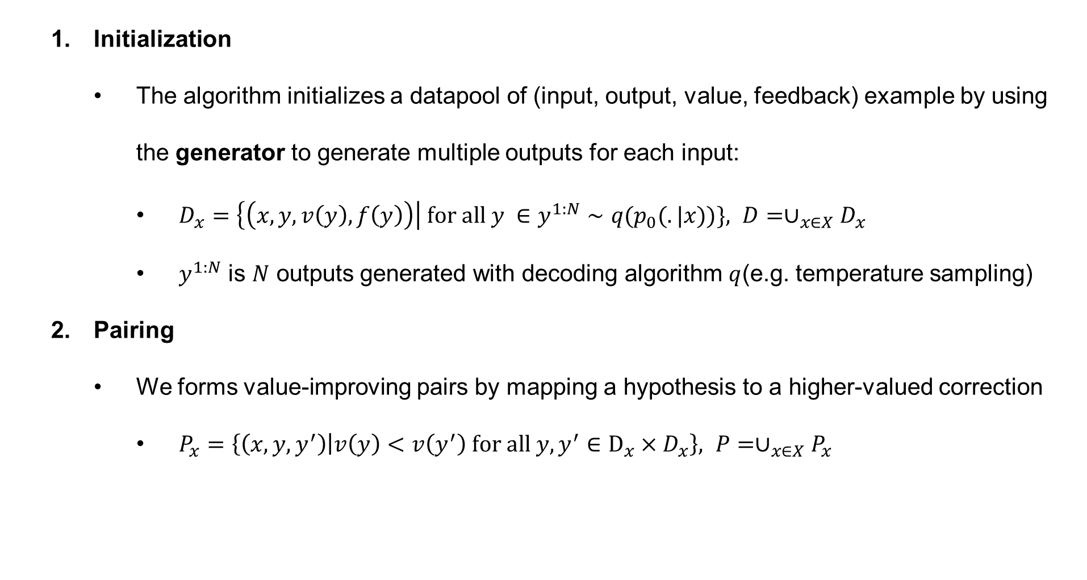
Approach: Learning a Corrector
Initialization
The algorithm initializes a datapool of (input, output, value, feedback) example by using the generator to generate multiple outputs for each input:
$D_{x}=\left\{\left(x,y,v\left(y\right),f\left(y\right)\right)\right| for all y ∈y^{1:N}∼q(p_{0}(.|x))\}, D=∪_{x∈X}D_{x}$
$y^{1:N}$ is $N$ outputs generated with decoding algorithm $q$(e.g. temperature sampling)
Pairing
We forms value-improving pairs by mapping a hypothesis to a higher-valued correction
$P_{x}=\left\{\left(x,y,y^{′}\right) | v\left(y\right)<v\left(y^{′}\right) for all y,y^{′}∈D_{x}×D_{x}\right\}, P=∪_{x∈X}P_{x}$
Notes:
在此之后，该方法将prompt输入到生成器中，并针对每个输入x生成出多个输出结果
然后将这些输出进行打分以及获取反馈
因此，可以将输入，输出，值，以及反馈整体构建成一个样本，并将这些样本组合成一个数据池
上述过程可以用公式进行描述，其中q是解码方法，比如一些采样方法等
Y1到n则是模型根据输入x生成出的n个输出结果
随后本文进行第二个步骤配对
该方法从数据池中选出两个样本，然后根据输出y上的分值大小进行配对
并要求y的评分要小于y‘
随后本文即可将y‘视作为生成结果y的一个矫正结果
而集合P中的这些配对即可以用来对矫正器进行训练

Slide 9
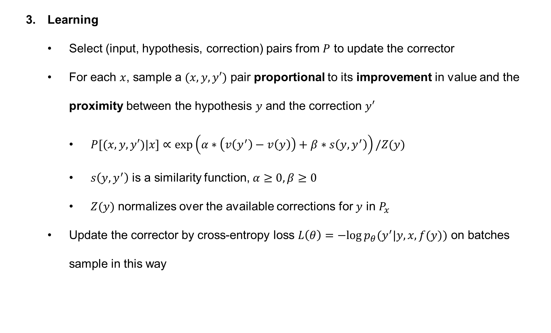
Approach: Learning a Corrector
Learning
Select (input, hypothesis, correction) pairs from $P$ to update the corrector
For each $x$, sample a $(x,y,y′)$ pair proportional to its improvement in value and the proximity between the hypothesis $y$ and the correction $y′$
$P[(x,y,y′)|x]∝exp\left(α∗\left(v\left(y^{′}\right)−v\left(y\right)\right)+β∗s\left(y,y^{′}\right)\right)/Z(y)$
$s\left(y,y^{′}\right)$ is a similarity function, $α≥0,β≥0$
$Z(y)$ normalizes over the available corrections for $y$ in $P_{x}$
Update the corrector by cross-entropy loss $L\left(θ\right)=−log⁡p_{θ}(y^{′}|y,x,f(y))$ on batches sample in this way
Notes:
随后本文进行第三个步骤学习
在从集合P中选取样本时，本文提出了一种新的采样方法
给定x时，训练样本xyy’的采样概率与两部分有关
分别是y和y‘之间值的improvement
以及y和y‘之间的相似程度
针对这两部分的超参数设置均设置为大于0
因此该采样方法要求y和y‘之间要有足够的性能改进，
并且因为两者之间充当了矫正前和矫正后的关系，因此其之间也要有一定的相似性，
随后本文根据采出的样本构建batch，使用交叉熵对矫正器进行训练
那么在具体实现时，本文将xyy‘用分割符进行拼接，然后用语言模型的自回归训练方式进行模型训练

Slide 10
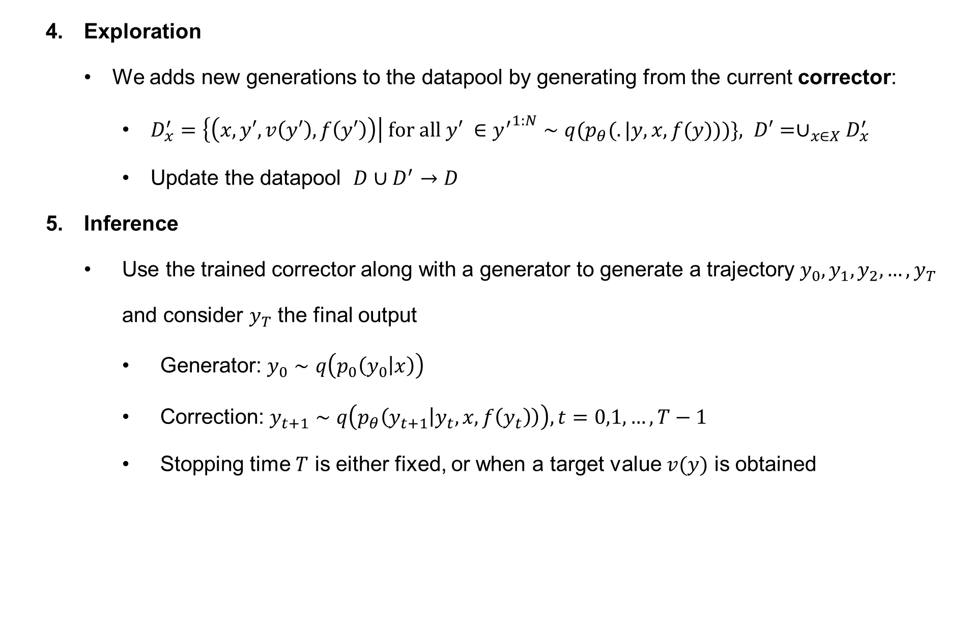
Approach: Learning a Corrector
Exploration
We adds new generations to the datapool by generating from the current corrector:
$D_{x}^{′}=\left\{\left(x,y′,v\left(y′\right),f\left(y′\right)\right)\right| for all y′ ∈{y^{′}}^{1:N}∼q(p_{θ}(.|y,x,f(y)))\}, D′=∪_{x∈X}D_{x}^{′}$
Update the datapool $D∪D^{′}→D$
Inference
Use the trained corrector along with a generator to generate a trajectory $y_{0},y_{1},y_{2},…,y_{T}$ and consider $y_{T}$ the final output
Generator: $y_{0}∼q\left(p_{0}\left(y_{0} | x\right)\right)$
Correction: $y_{t+1}∼q\left(p_{θ}\left(y_{t+1} | y_{t},x,f\left(y_{t}\right)\right)\right), t=0,1,…,T−1$
Stopping time $T$ is either fixed, or when a target value $v(y)$ is obtained
Notes:
随后本文进行第四个步骤 探索
在这个步骤中，该方法将y输入到矫正器中生成出y‘，然后将其输入到数据池中以进行扩充
上述步骤1到步骤4构建了模型的整体训练过程
在最后推理时，模型结合生成器和矫正器，
从而可以根据输入x生成出一个输出轨迹
并将yt作为最终输出结果
其中迭代轮数T即可是固定的，也可以当y的值达到要求时进行停止

Slide 11
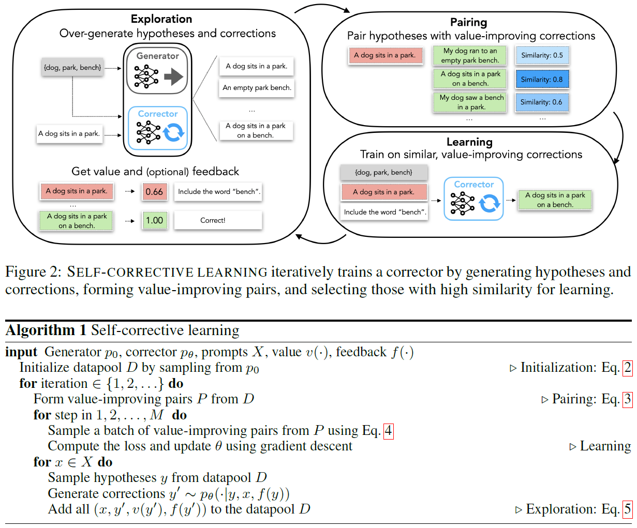
Approach
Notes:
整体算法如上所示，可以暂停看一下

Slide 12
Experiments
We evaluate on there task: mathematical program synthesis, lexically-constrained generation and toxicity control
our experiments are organized to study three settings:
Using self-correctors to improve upon generators
Correcting generators that are much larger than the corrector
Leveraging explicit feedback during training and inference
Notes:
本文在三个任务上进行了实验，
并主要研究三个方面
其一，使用自校正器提升生成器性能
其二，将矫正器应用于更大的生成器中
其三，在训练和推理过程中使用反馈

Slide 13
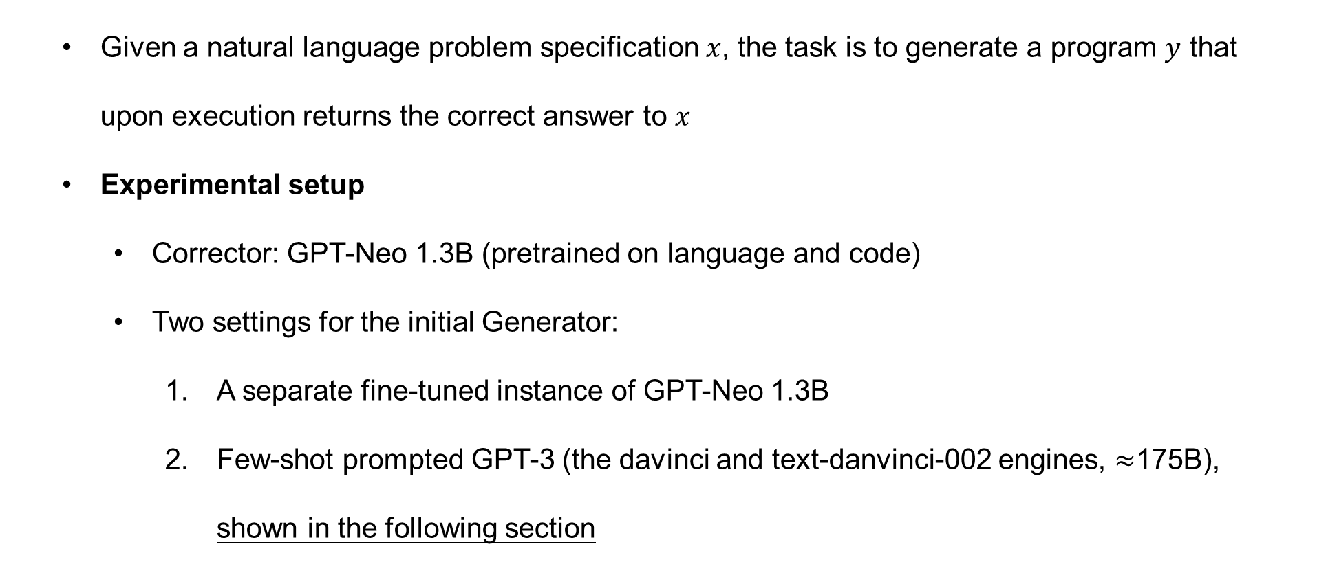
Experiments: mathematical program synthesis
Given a natural language problem specification $x$, the task is to generate a program $y$ that upon execution returns the correct answer to $x$
Experimental setup
Corrector: GPT-Neo 1.3B (pretrained on language and code)
Two settings for the initial Generator:
A separate fine-tuned instance of GPT-Neo 1.3B
Few-shot prompted GPT-3 (the davinci and text-danvinci-002 engines, $≈$175B), shown in the following section
Notes:
实验1，数学程序生成，给定模型问题描述x，要求生成出python程序代码y，以执行并返回正确结果
该实验中本文使用GPTneo1.3b作为矫正器，该模型提出时在自然语言和代码上均进行了预训练
生成器部分本文选择两种设置
其一，另一个针对该任务微调的gptneo模型
其二，使用fewshotprompt的gpt3，那么第二种设置具体在该实验的后续其他实验中进行了阐述

Slide 14
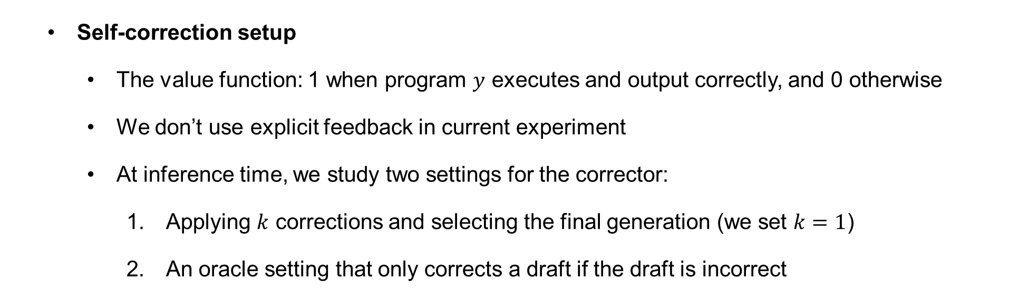
Experiments: mathematical program synthesis
Self-correction setup
The value function: 1 when program $y$ executes and output correctly, and 0 otherwise
We don’t use explicit feedback in current experiment
At inference time, we study two settings for the corrector:
Applying $k$ corrections and selecting the final generation (we set $k=1$)
An oracle setting that only corrects a draft if the draft is incorrect
Notes:
该任务选用的值函数输出为0或1，且仅当输出程序能够执行并返回正确结果时为1，否则为0
在当前实验中暂且不使用显示反馈
在推理时本文采用了两种设置
其一，使用矫正器进行k次矫正，其中k设置为1
其二为oracle设置，仅使用矫正器矫正错误的生成结果

Slide 15
Experiments: mathematical program synthesis
Datasets
MultiArith, from the MultiArith arithmetic word problem dataset
Multitask, from 4 arithmetic datasets (MultiArith, AddSub, SingleOp, SVAMP)
GSM, from the challenging GSM8k dataset
Baselines
We compare SELF-CORRECT with its fine-tuned baseline generator (GPT-Neo 1.3B)
For GSM, we additionally compare with existing work by (Ni et al):
NEO FCP+PCP, tunes GPT-NEO 2.7B with additional self-sampled programs
fine-tuned GPT-NEO 2.7B
3B and 6B finetuned GPT3-like language models from (Cobbe et al)
Notes:
本文选取了三个难度逐渐增加的数据集
MultiArith （er riths）
Multitask
和GSM
Baseline首先包括了在当前任务上进行微调过的生成器，
在GSM数据集上，还额外包括了以往的一些工作，这些方法主要基于gptneo2.7b进行设计
此外本文又引入了3b和6b的微调后的gpt3模型作为基线

Slide 16
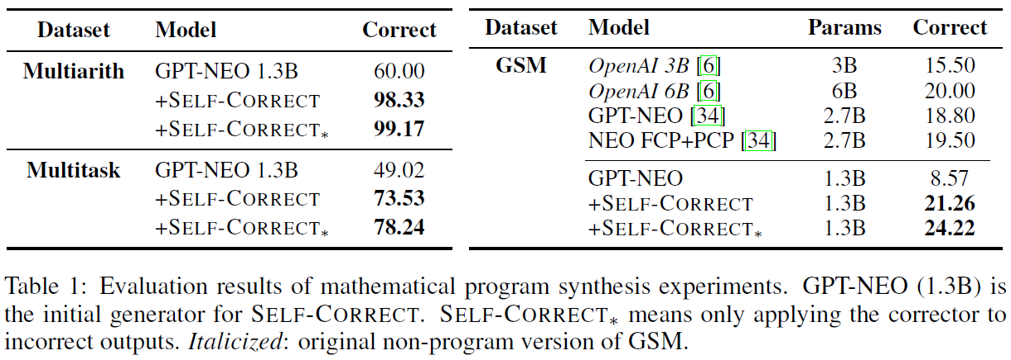
Experiments: mathematical program synthesis
Results
the self-corrector improves upon the generator in all three dataset using either inference strategy: always correcting or only correcting incorrect solutions
On the challenging GSM dataset, self-corrector outperform larger 2.7B GPT-Neo(also larger than generator+corrector), or larger models tuned on GSM
Notes:
实验结果如表所示
可以发现，本文方法在三个数据集的两种推理策略中相比于生成器均有提升，
其中不加星号的为所有生成结果均矫正1次，而带星号的为仅矫正错误的模型输出
可以发现，第二种策略要比第一种要好，应该是说明了矫正器也有可能将本来已经正确的结果给矫正错了
此外可以发现，本文方法相比于更大参数的其他模型性能要更好

Slide 17
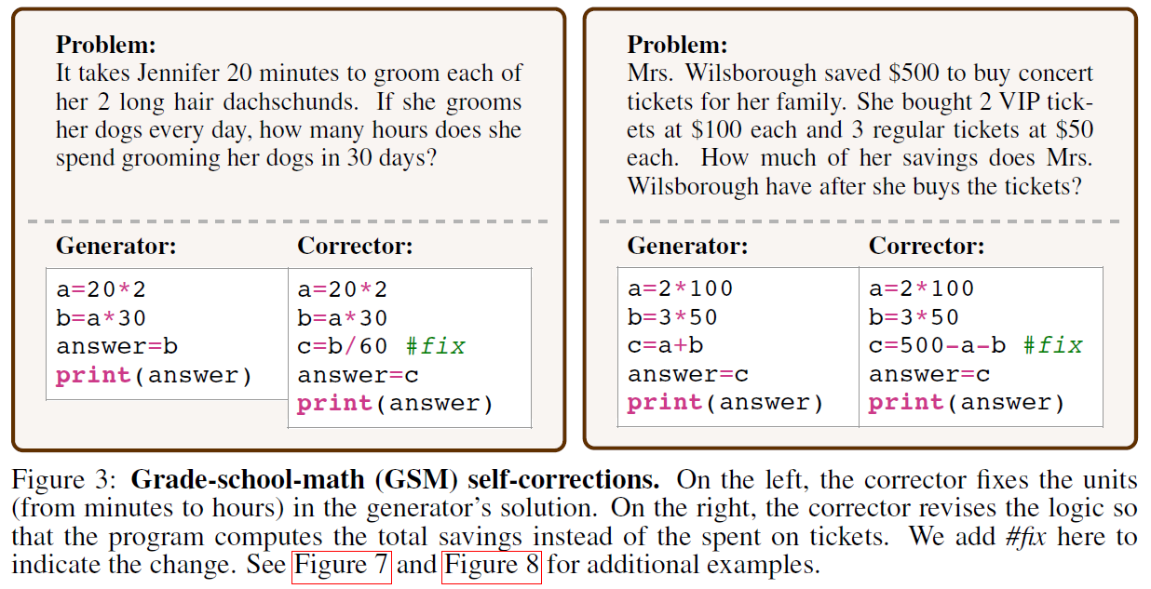
Experiments: mathematical program synthesis
Results
Notes:
如图所示为该实验的几个例子
标fix的一行即为矫正器的修改结果

Slide 18
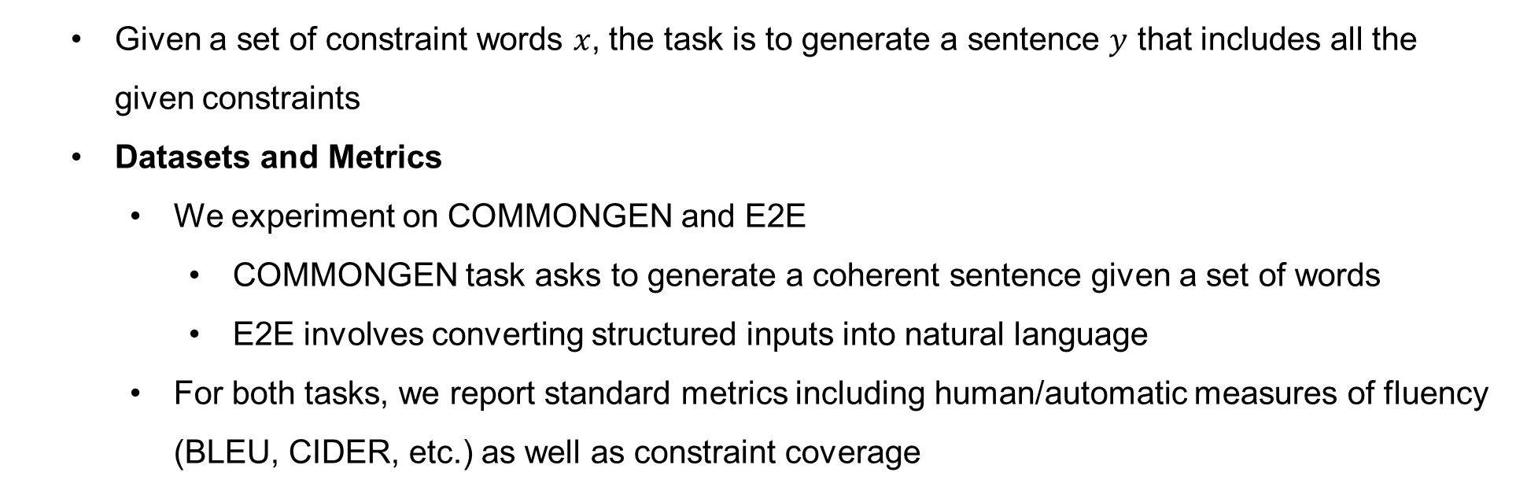
Experiments: lexically constrained generation
Given a set of constraint words $x$, the task is to generate a sentence $y$ that includes all the given constraints
Datasets and Metrics
We experiment on COMMONGEN and E2E
COMMONGEN task asks to generate a coherent sentence given a set of words
E2E involves converting structured inputs into natural language
For both tasks, we report standard metrics including human/automatic measures of fluency (BLEU, CIDER, etc.) as well as constraint coverage
Notes:
实验二为词汇限制生成
给定限制单词集合，该任务要求模型生成一个句子y包含所有的限制单词
该实验选用了commongen和e2e两个数据集
前者输入为单词集合，后者则要求将结构化的输入转换为一段自然语言
两个任务选用bleu、cider，以及单词的覆盖率等指标进行评测，这些指标均为值越大越好

Slide 19
Experiments: lexically constrained generation
Setup
base generator: GPT-2 (large-size for COMMONGEN and medium-size for E2E), finetuned for each task
value function: coverage i.e. the percentage of constraints present in the output
For inference, we use beam search with generator, then do up to 3 corrections using beam search, stopping early if all constraints are met
Notes:
生成器本文选用了gpt2两个版本的模型，并根据两个任务进行了微调
值函数本文选用了限制单词的覆盖率
在推理时本文选取了beam search来生成出多个结果
并至多矫正三次，且当所有限制满足时提前停止矫正
可能是作者漏写了，文章里没找到是具体用了什么模型来做为矫正器，猜测的话大概也是同参数的模型

Slide 20
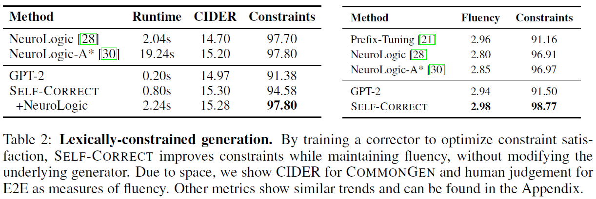
Experiments: lexically constrained generation
Results
Self-corrector improves constraint coverage over its GPT-2 generator for both tasks, while maintaining or improving its language quality
On COMMONGEN, the self-corrector paired with the NeuroLogic constrained decoding algorithm achieves the best results, while being an order of magnitude faster
On E2E, self-correction outperforms Neurologic-A* decoding despite only using standard beam search
Notes:
实验结果如表所示
本文方法提升了生成器的覆盖率，并维持或改进了文本的语言质量
在commongen数据集中，本文方法可以和基线解码方法进行结合，从而实现了最好的结果，并有着更快的运行速度
在e2e数据集中，本文方法仅使用了beam search即实现了最好的实验结果

Slide 21
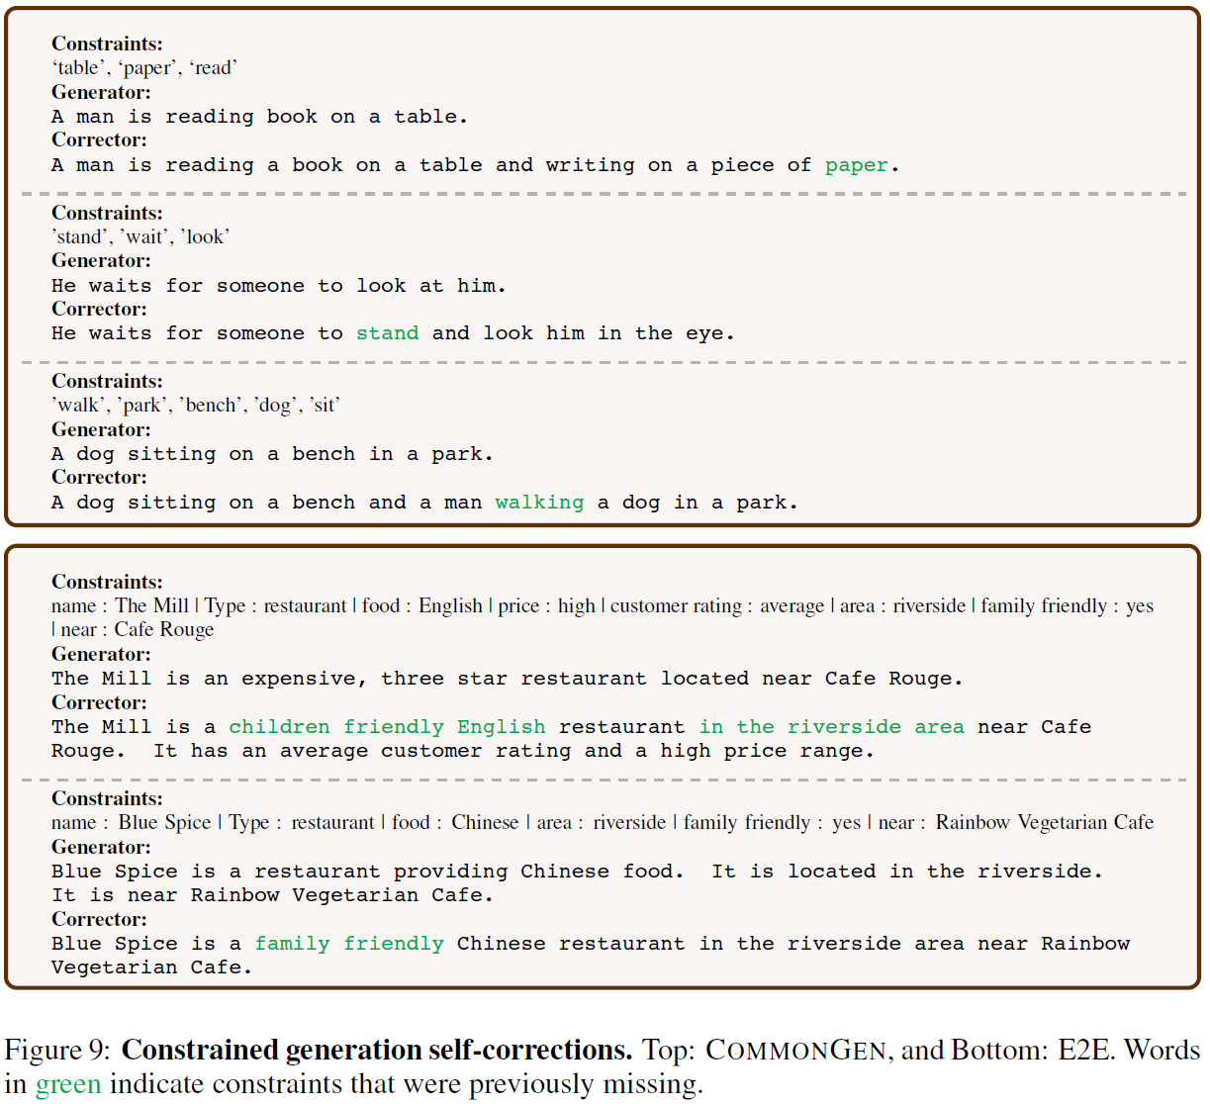
Experiments: lexically constrained generation
Results
Notes:
如图所示为该实验的几个样例

Slide 22
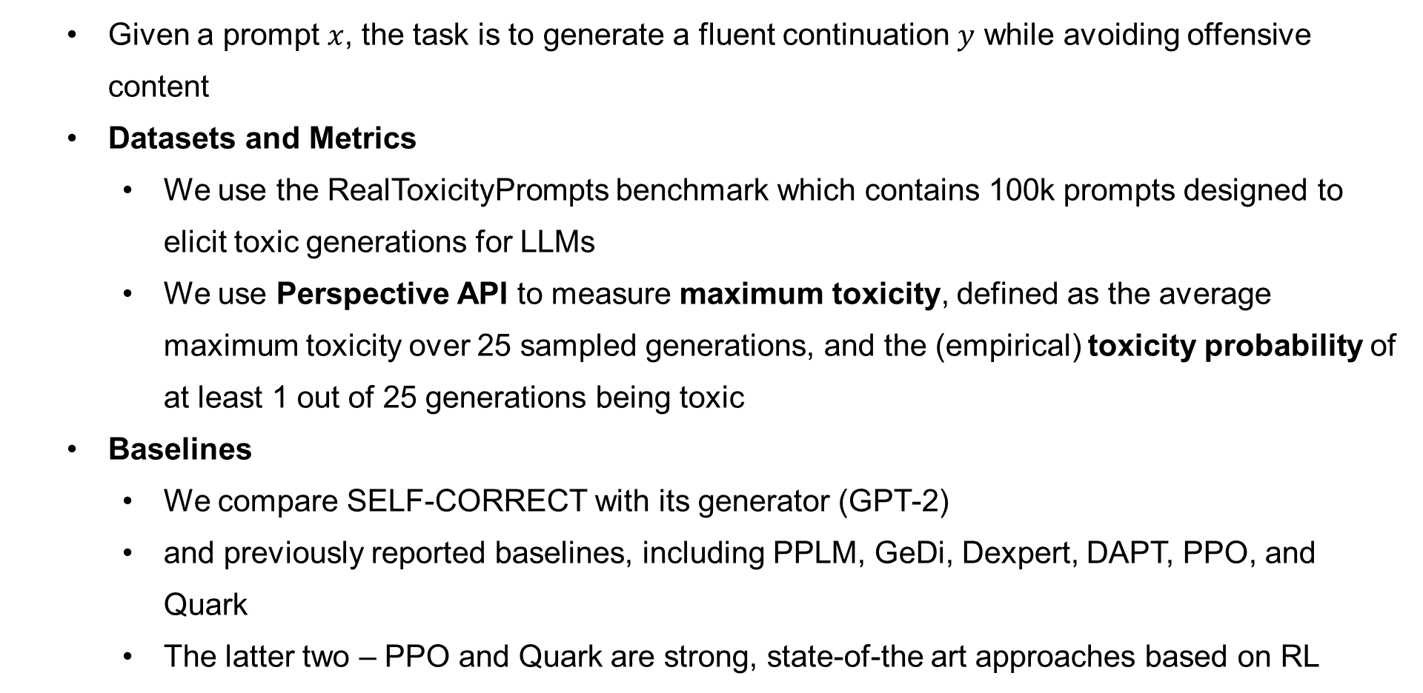
Experiments: toxicity reduction
Given a prompt $x$, the task is to generate a fluent continuation $y$ while avoiding offensive content
Datasets and Metrics
We use the RealToxicityPrompts benchmark which contains 100k prompts designed to elicit toxic generations for LLMs
We use Perspective API to measure maximum toxicity, defined as the average maximum toxicity over 25 sampled generations, and the (empirical) toxicity probability of at least 1 out of 25 generations being toxic
Baselines
We compare SELF-CORRECT with its generator (GPT-2)
and previously reported baselines, including PPLM, GeDi, Dexpert, DAPT, PPO, and Quark
The latter two – PPO and Quark are strong, state-of-the art approaches based on RL
Notes:
第三个实验为毒性降低
给定一个输入prompt，该任务要求模型生成y中避免出现攻击性的内容
数据集本文选用了RealToxicityPrompts benchmark，其中包含了10w个prompt，这些prompt会诱导模型生成出有毒的内容
本文使用了该任务上的一个api来测试文本的毒性，并包含了两种计算方式
给定输入x，模型随机采样生成出25个样本，然后求这些样本的最大毒性
以及25个样本中至少有1个为有毒样本的毒性概率
Baseline部分首先于其生成器gpt2进行比较，
且也比较了之前该任务上的一些工作
在这些工作中，较强的基线模型PPO和quark均为基于强化学习的模型算法

Slide 23
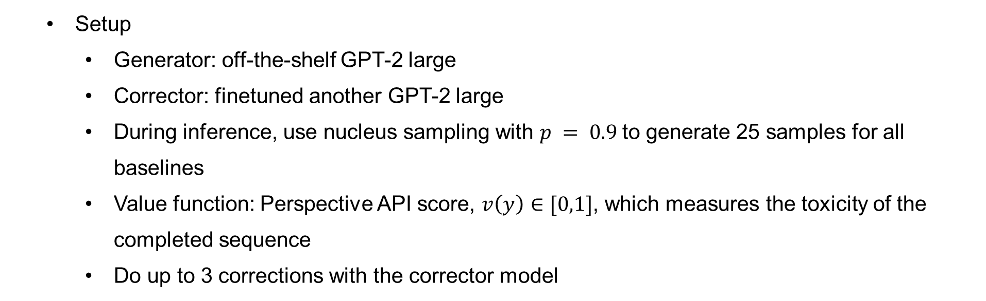
Experiments: toxicity reduction
Setup
Generator: off-the-shelf GPT-2 large
Corrector: finetuned another GPT-2 large
During inference, use nucleus sampling with $p = 0.9$to generate 25 samples for all baselines
Value function: Perspective API score, $v\left(y\right)∈[0,1]$, which measures the toxicity of the completed sequence
Do up to 3 corrections with the corrector model
Notes:
生成器本文选用了未经过微调了gpt2large
矫正器选取了另一个微调过的gpt2large
在推理时本文使用核采样方法生成出25个样本
本文使用该任务上专用的api来打分，其范围为0到1，用以测量毒性程度
本文使用矫正器至多进行三次矫正

Slide 24
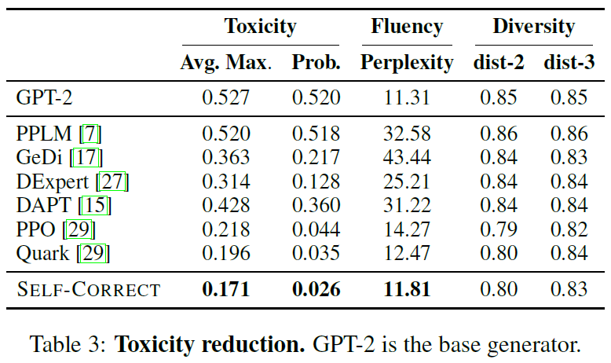
Experiments: toxicity reduction
Results
SELF-CORRECT reduces the rate of toxic generations substantially, while also maintaining fluency and diversity
SELF-CORRECT outperforms all baselines, while the strong baselines use equal or more parameters(PPO and Quark use 3 and 2 model copies)
Notes:
实验结果如表所示
结果表明，本文方法减小了本文毒性，同时维持了文本的流畅程度和多样性
此外，本文方法相比于同等或更大参数的基线模型效果更好

Slide 25
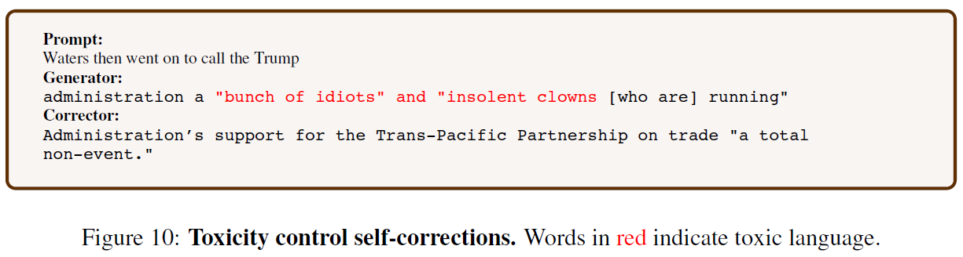
Experiments: toxicity reduction
Results
Notes:
如图所示为该实验的一个例子

Slide 26
Experiments: correcting GPT-3
we show that a self-corrector can improve the outputs of a generator that is much larger than the corrector, and consider two cases:
training with a small generator, then swapping in the larger generator at test time
training with the larger generator, i.e. using the large generator to initialize the datapool for self-corrective learning, then using the large generator at test time
Experiment on Math program synthesis and Toxicity
Notes:
随后本文对gpt3进行矫正实验
并研究本文方法能否对比矫正器大得多的生成器起到矫正作用
其中包含了两种情况
其一，与较小的生成器结合进行训练，并将训练后的矫正器直接应用于更大的生成器中
其二，直接与更大的生成器结合进行训练，
该实验本文选取了数学程序生成和毒性降低两个任务

Slide 27
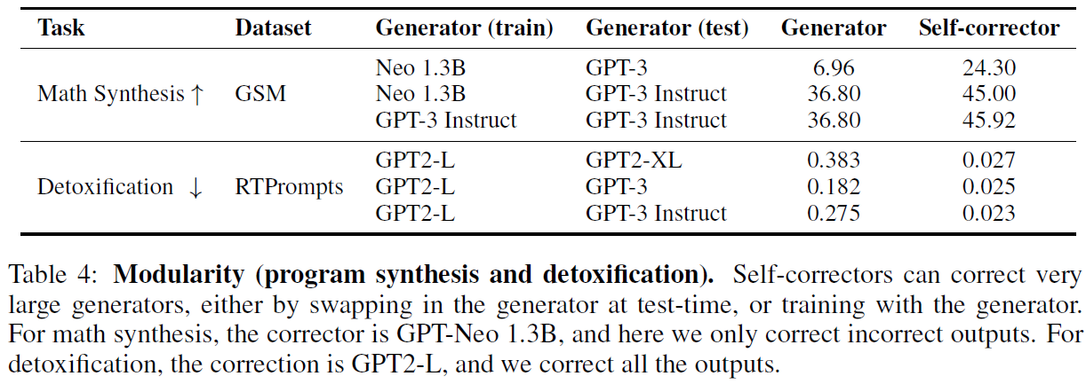
Experiments: correcting GPT-3
Experiments: Math program synthesis
Results1: the corrector is able to correct larger generators swapped in at test-time
Results2: The self-corrector improves further by training with the GPT-3 Instruct generator
Experiments: Toxicity
We generate an initial sequence using the large generator, then refine it with our corrector trained in the previous experiments
Results: the self-corrector has substantially reduced toxicity of the large generator
Notes:
实验结果如表所示，
在数学程序生成任务上可以发现，在相对较小的生成器上训练的矫正器可以直接应用到gpt3模型上去
其二，将gpt3模型作为生成器以训练矫正器可以进一步提升结果
在毒性任务上可以发现，在较小的生成器上训练的矫正器可以对更大的生成器起到毒性降低的作用

Slide 28
Experiments: leveraging explicit feedback
Experiment: Toxicity
We use additional fine-grained information from the toxicity API as natural language feedback
besides the overall toxicity score, Perspective API also provides scores for fine-grained attributes of toxicity (e.g. identity attack, profanity, flirtation, etc.)
At training time, we compare the attribute scores from a hypothesis and its selected correction, and use the attribute with the largest decrease as natural language feedback
e.g. "decrease toxicity in profanity"
At inference time, we call the API on the current hypothesis and use the attribute with the highest score
Notes:
本文随后研究了在模型训练过程中添加反馈
在毒性任务中，本文将api产生出的细粒度信息作为自然语言反馈
该api能够从多个方面对本文的毒性进行评测
具体而言，在训练时，本文对比了y和y‘之间的api分值，并比较两者之间差距最大的一个细分项，来提供反馈
比如y和y‘相比，在profanity这一项中有较大的提升空间，那么自然语言反馈则要求模型着重降低profanity（亵渎）
在推理的时候，本文调用api对输出进行评测，然后针对最差的那一项属性，给予模型反馈，要求其对该项进行降低

Slide 29
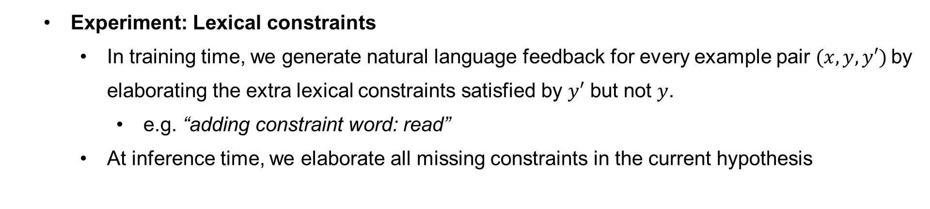
Experiments: leveraging explicit feedback
Experiment: Lexical constraints
In training time, we generate natural language feedback for every example pair $(x, y, y′)$by elaborating the extra lexical constraints satisfied by $y′$ but not $y$.
e.g. “adding constraint word: read”
At inference time, we elaborate all missing constraints in the current hypothesis
Notes:
在词汇限制任务中，本文根据y和y‘之间的限制词差异提供反馈
比如对比发现，y相比于y‘没有包含限制词read
那么就反馈模型在y中额外添加read这个单词
在推理时，则选取当前输出中所有未能满足的限制词，然后给予模型相应的自然语言反馈

Slide 30
Experiments: leveraging explicit feedback
Experiment: Math program synthesis
Math program synthesis contains a variety of problem types and errors, without an automated means for identifying the errors (e.g. an API)
We explore obtaining natural language feedback about the current program by prompting a large language model
We prompt LLM with a problem, hypothesis program, a gold solution, and few-shot demonstrations that show feedback on one part of the program
e.g. “In the initial guess, 3 should be subtracted”
When the program is correct, the feedback is Correct
At inference time, we also use feedback from the language model
Noted: We allow the feedback model access to a gold solution, which we expect makes the feedback higher quality, with the risk of solution leakage at inference-time
Notes:
在数学模型生成任务中
由于该任务中可能生成出包含各种不同错误的样本，因此无法用自动化的方法给予反馈
因此本文探索了使用带有prompt的LLM来生成反馈
本文在LLM中输入的prompt中包含问题描述，生成程序，标准答案，以及fewshot的样例，然后使用LLM生成出反馈
随后并使用该反馈指导矫正器训练和推理
因此值得注意的是，作者指出在该实验中其实存在了泄露标准答案的风险

Slide 31
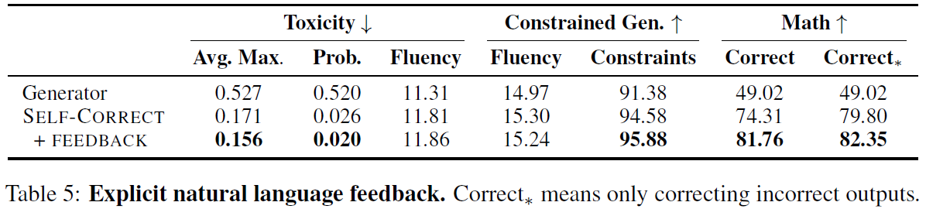
Experiments: leveraging explicit feedback
Setup
For toxicity, lexical constraints, and math we use REALTOXICITYPROMPTS, COMMONGEN, and the MULTITASK arithmetic tasks, respectively
We follow the setup of each task’s previous experiments, except for math use 5 correction iterations (previously 1)
For math, we use GPT-3 (text-davinci-002) with 6 demonstrations as the feedback model
Results
explicit natural language feedback improves performance in all three tasks
Notes:
实验结果如表所示，可以发现，自然语言反馈均能够提升三个任务上的性能表现

Slide 32
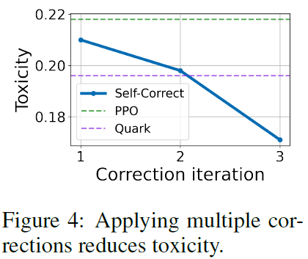
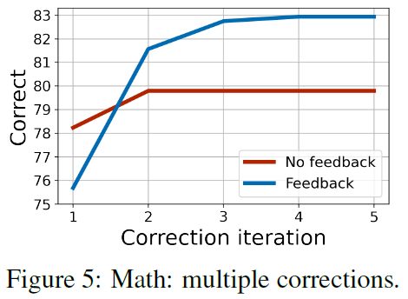
Experiments: ablations
Effect of multiple corrections
multiple corrections led to better toxicity reduction
On math, performance improves with more than one correction, and that multiple corrections are more beneficial with feedback
In this math task, after 2-3 corrections the model needs additional guidance
Notes:
消融实验部分作者首先探究了矫正次数对性能的影响
可以发现，多次矫正能够更好地降低毒性
在数学任务中，多次矫正能够提升结果，且带有反馈时多次矫正能够更加有效
此外可以发现，在2到3次矫正时，模型有很大必要获取额外的反馈从而提升性能表现

Slide 33
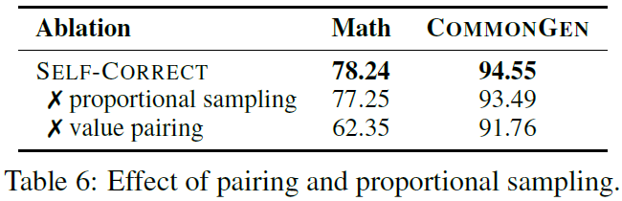
Experiments: ablations
Effect of pairing and proportional sampling
Self-corrective learning
samples pairs for learning proportional
only pairs sequences that improve value
We ablate these features by (1) training on Multitask using a data pool that samples a pair for learning uniformly and (2) a data pool without value pairing
Table 6 shows that both improve performance.
Notes:
本文方法包含了成比例的样本采样，以及样本之间根据值的对比以构建样本对的过程
因此本文进行消融实验以分别取消了成比例的采样方法，以及值配对的方法
并发现两者均能够提升模型性能

Slide 34
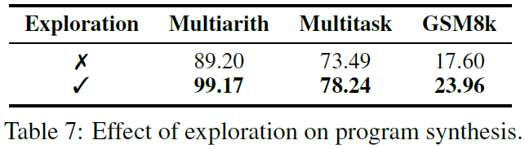
Experiments: ablations
Effect of exploration
To ablate the effect of exploration, we train a baseline only on correction pairs induced from the base generator
Table 7 shows results on the three math datasets, indicating that exploration improves performance
Notes:
本文最后探究了探索步骤的作用
并仅使用了基生成器生成的样本来构建训练样本对
可以发现，在数学任务中探索步骤能够有效改善模型性能

Slide 35
Conclusion
We introduced self-correctors, a class of models that decompose generation into initial generation and correction steps
We presented a simple, general procedure for training the corrector, and find that self-correction is applicable and effective for improving performance, and controlling the outputs of both small and large generators
We provides a promising mechanism for using natural language feedback to improve generation, opening many avenues for future work
Notes:
总结来看，
本文提出了自校正器，并提出了针对该模型的一个简单且通用的训练流程，并取得了很好的效果
此外该方法能够引入自然语言反馈，从而能够对未来工作起到启发

